Slide 1

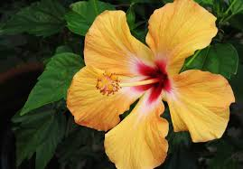
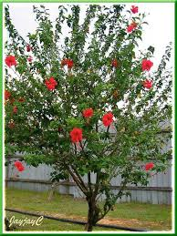
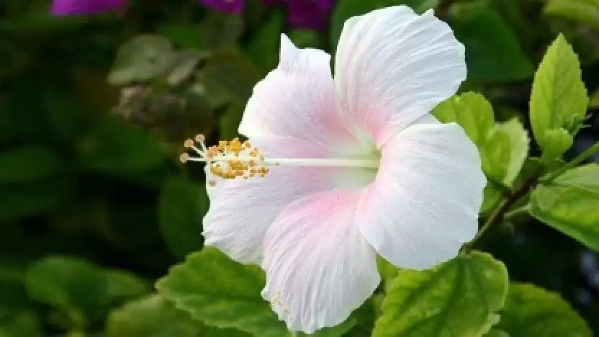
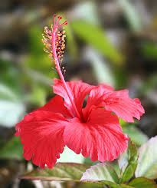
Hibiscus

Slide 2
Common Name : Hibiscus
Scientific Name : Hibiscus rosa-sinensis
Family : Malvaceae
Habit : Hibiscus rosa-sinensis grows as a shrub to small tree to 5 m in height. The leaves are arranged alternately, to 15 cm long, ovate with an acute/acuminate leaf apex, crenate margin and rounded leaf base. The complete, perfect, actinomorphic flowers are solitary or in pairs in leaf axils.
Distribution : It is widely distributed in following countries: India (south western regions), Sri-Lanka (tropical regions), Thailand, South Africa, Phillipines, Myanmar, China and Pakistan. Hibiscus rosa-sinensis is a perennial shrub having tap root system. Its leaves are 6 to 15 cm long and 2 to 5 cm wide.

Slide 3
Description :
Bark and Trunk: Trunk of this plant is used commercially for netting, bags, ropes, and various handicrafts due to its fiber and cellulose content. Similarly, the fiber from hibiscus is known to be strong and tough. Hibiscus bark is rough, but it almost never has large round bumps on it.
Leaves: Hibiscus leaves are ovate, simple and 8 to 10.5 cm long. They are spirally arranged around a long stalk.
Flowers: Member species of hibiscus are renowned for their large, showy flowers and those species are commonly known simply as “hibiscus”, or less widely known as rose mallow. The usually solitary bell-shaped flowers typically have three petals and three petal-like sepals.
Fruits: The fruit of the hibiscus flower is a capsule or five lobed pods which is located just below the flower. The seeds are present within the lob like any other fruit. So the hibiscus plant does not have any distinct fruit.
Growth and Lifespan: The older garden varieties could live up to 50 years and grow to heights of 10-15 feet or more, while some of the newer hybrids have lifespans of 5-10 years and only grow a few inches a year. Tropical hibiscus will survive year-round outdoors either in a pot or planted in the ground. Perennial hibiscus generally reach their mature height within two or three years and return to that height each year.

Slide 4
USES :
Wood (Trunk and Branches):
Crafts and Small Projects: The wood from hibiscus can be used for crafting small items like pens, jewelry, and carvings. Its texture and appearance can make it a good choice for artistic endeavors.
Traditional Uses: In some cultures, hibiscus wood is used for traditional purposes such as making tools or utensils.
Ornamental Uses: The wood can be used in decorative items or as part of garden features, like trellises or small sculptures.
Leaves:
Salads: Young hibiscus leaves can be used fresh in salads. They have a slightly tangy flavor, which can add a unique taste to dishes.
Traditional Remedies: Hibiscus leaves are used in traditional medicine to treat a variety of ailments. They are believed to have anti-inflammatory and antimicrobial properties.
Skin Care: In some cultures, hibiscus leaves are used in topical applications for their purported skin-soothing properties. They might be used in poultices or masks for their potential benefits to the skin.

Slide 5
Flowers:
Herbal Teas: Hibiscus flowers are most commonly used to make herbal teas, known for their tart flavor and vibrant red color. The tea is enjoyed hot or cold and is often sweetened or flavored with spices and fruits.
Health Benefits: Hibiscus flowers are known for their high antioxidant content and are used in traditional medicine to help with various health issues. They are believed to support cardiovascular health, lower blood pressure, and have anti-inflammatory and diuretic effects.
Pods and Seeds:
Seed Harvesting: The primary use of hibiscus pods is to harvest the seeds. These seeds can be used for propagation, ensuring the continuation of the plant for ornamental or agricultural purposes.
Propagation: Hibiscus seeds are used for growing new plants. They can be sown to grow new hibiscus plants for gardens or landscapes.

Slide 6
Bark:
Traditional Medicine: In various traditional medicine systems, hibiscus bark is used for its purported medicinal properties. It is believed to have anti-inflammatory, antimicrobial, and astringent qualities. It can be used in the form of decoctions or poultices to treat wounds, skin conditions, or digestive issues.
Crafts and Textiles: The bark can be processed into fibers and used in making traditional textiles, ropes, and crafts. In some cultures, it is woven into mats, baskets, or used as a component in traditional garments.
Roots:
Herbal Medicine: Hibiscus roots are used in traditional medicine systems for their purported health benefits. They are believed to have anti-inflammatory, antimicrobial, and analgesic properties. Roots may be used in tinctures, teas, or poultices to help with conditions such as arthritis, digestive issues, or skin ailments.
Rituals and Ceremonies: In certain cultures, hibiscus roots are used in traditional rituals or ceremonies. Their use can vary based on local customs and spiritual practices.

